Slide 1
Ch 02 – Iteration bound (Giới hạn lặp)
ĐHBK Tp HCM
BMĐT
GV: Hồ Trung Mỹ
TLTK:
Các slide từ sách của Prof. Parhi
Slide của Prof. Viktor Öwall
KTGHK cũ

Slide 2
Tóm tắt chương 1
Chapter 1. Introduction to DSP Systems
Introduction (Read Sec. 1.1, 1.3)
Non-Terminating Programs Require Real-Time Operations
Applications dictate different speed constraints
(e.g., voice, audio, cable modem, settop box, Gigabit ethernet, 3-D Graphics)
Need to design Families of Architectures for specified algorithm complexity and speed constraints
Representations of DSP Algorithms (Sec. 1.4)

Slide 3
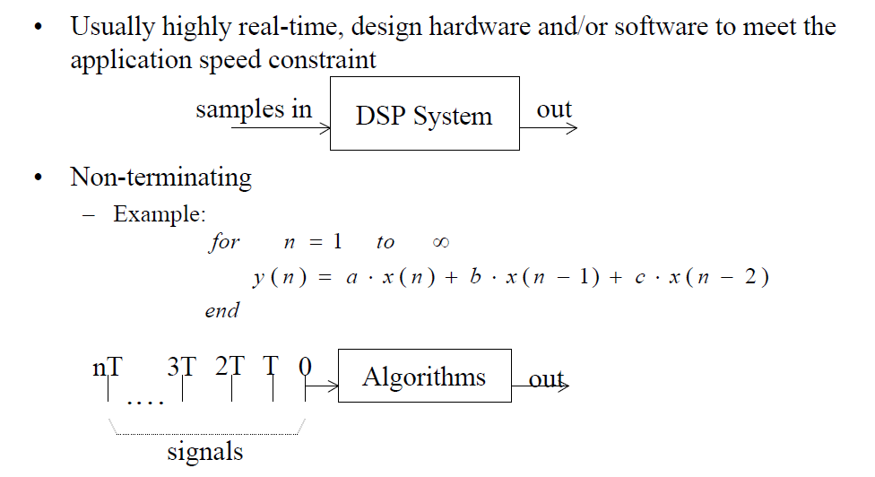
Typical DSP Programs
infinite input stream (samples): x(0), x(1), x(2), …
infinite output stream (samples): y(0), y(1), y(2), …
there may be multiple input and/or output streams
non-terminating program:
for n=1 to ∞
y(n) = a*x(n) + b*x(n-1) + c*x(n-2)
end

Slide 4
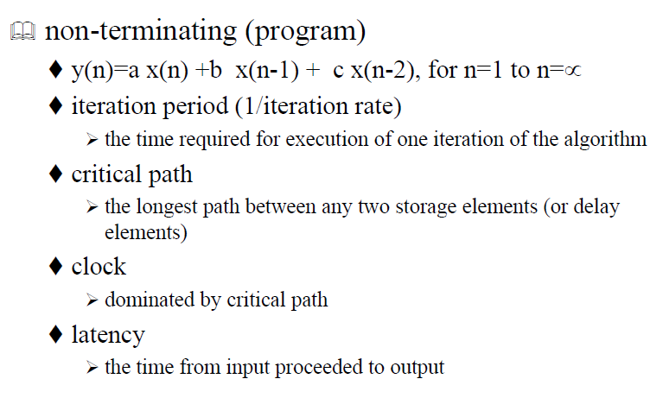
Representation of DSP algorithms
Sampling rate = nr. of samples processed/second
Latency = time difference between output and corresponding input
Combinatorial logic = gate delays
Sequential logic = nr. of clock cycles

Slide 5
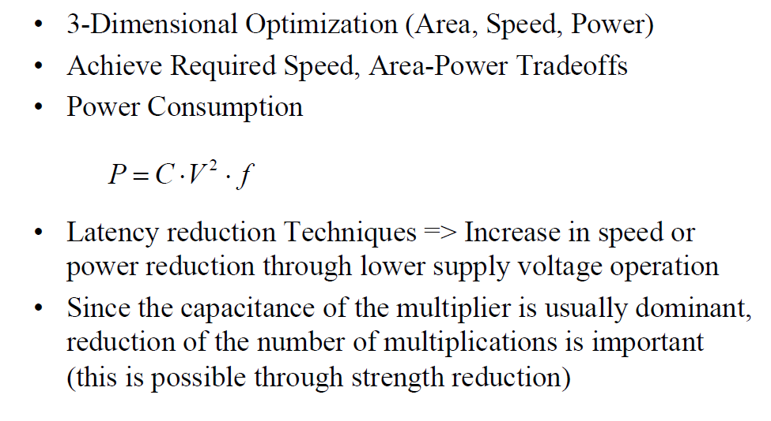
Area-Speed-Power Tradeoffs

Slide 6
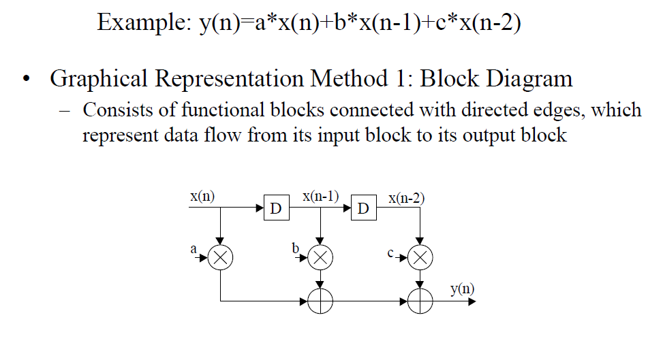
Representation Methods of DSP systems

Slide 7
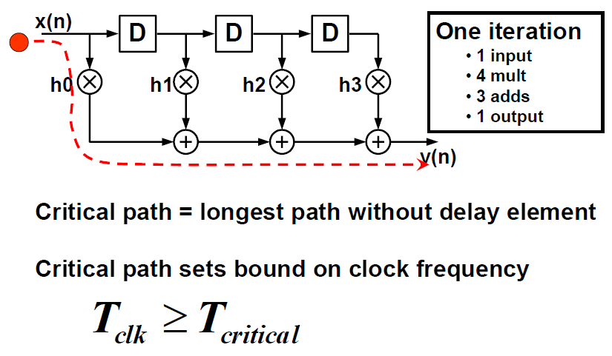
Ex: Direct Form 4-tap FIR
Note:
Clock speed limited by Critical Path!
T_{Critical} = T_{M} + (N-1)T_{A}
N = Nr. of Taps

Slide 8
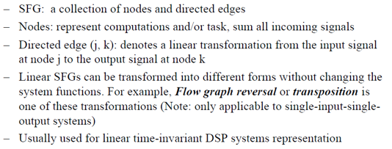
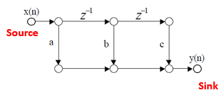
Graphical Representation Method 2: Signal-Flow Graph (SFG)
Note:
Source = no entering edge
Sink = only entering edges

Slide 9
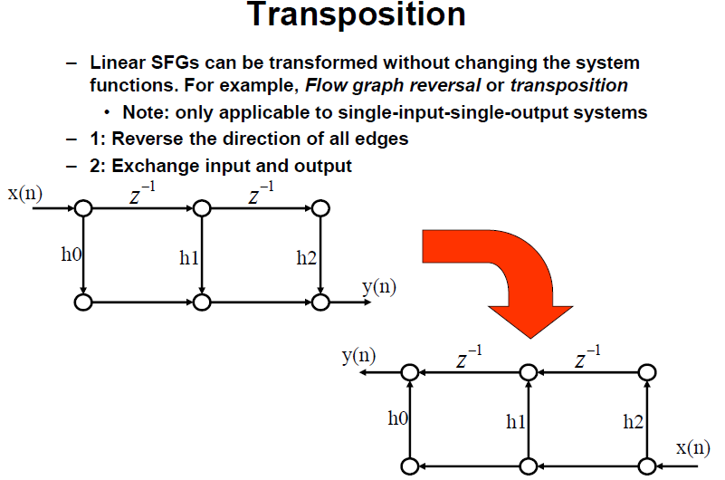

Slide 10
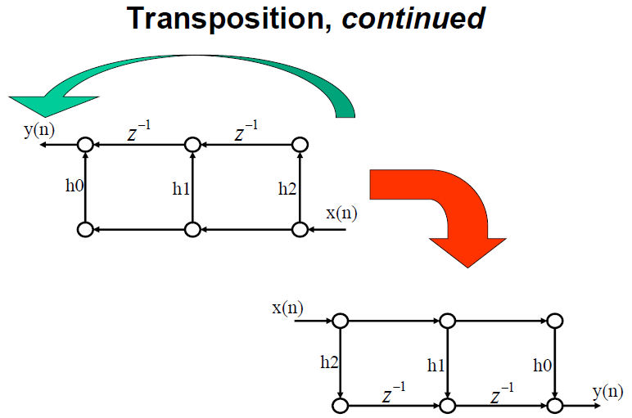

Slide 11
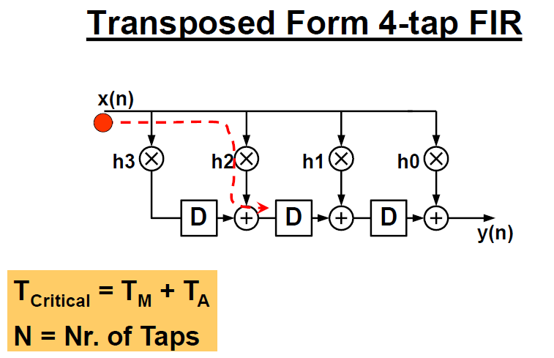

Slide 12
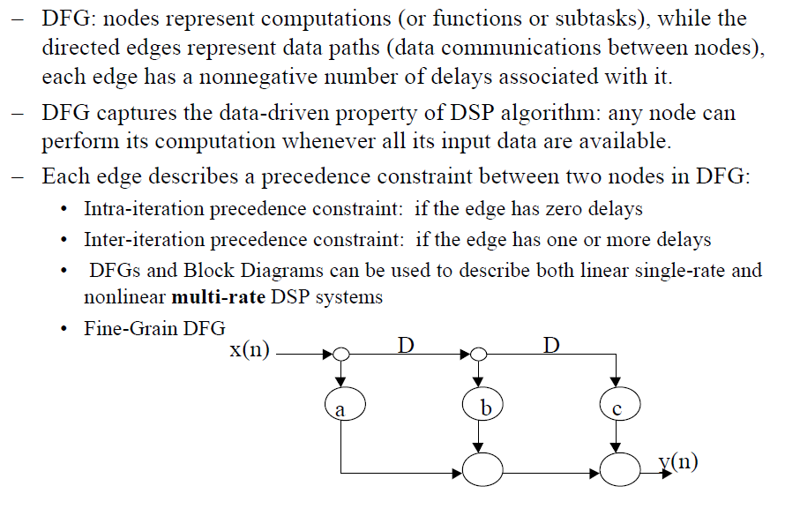

Graphical Representation Method 3: Data-Flow Graph (DFG)

Slide 13
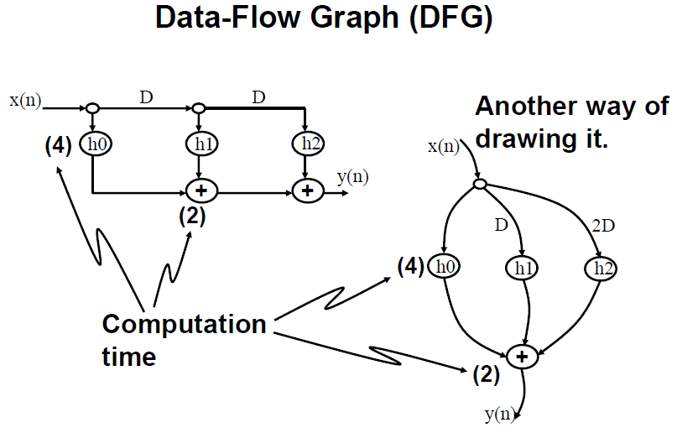

Slide 14
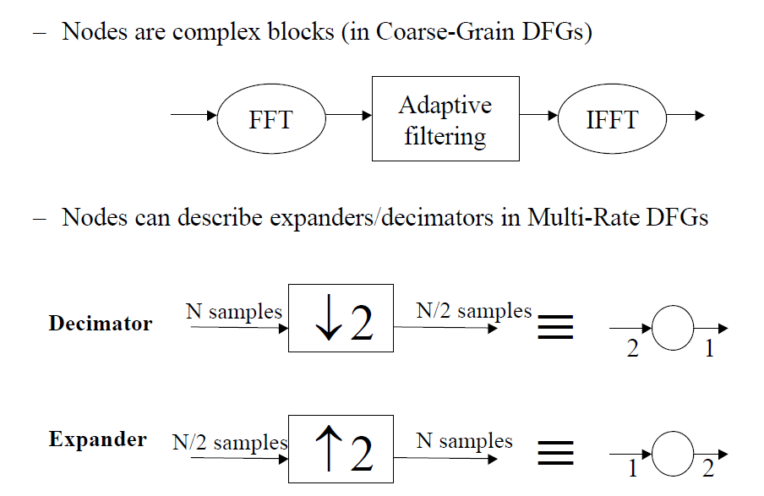
Examples of DFG
SDFG (Synchronous DFG)

Slide 15
Examples of DFGs
Nonrecursive DFG
x(n)
x(n)
D
D
z⁻¹
z⁻¹
(4)
(4)
(4)
A
B
C
y(n)
(2)
(2)
y(n)
D
E
indicates time units to complete node operation
Recursive DFG
x(n)
(2)
x(n)
y(n)
y(n)
A
z⁻¹
D
(4)
B

Slide 16
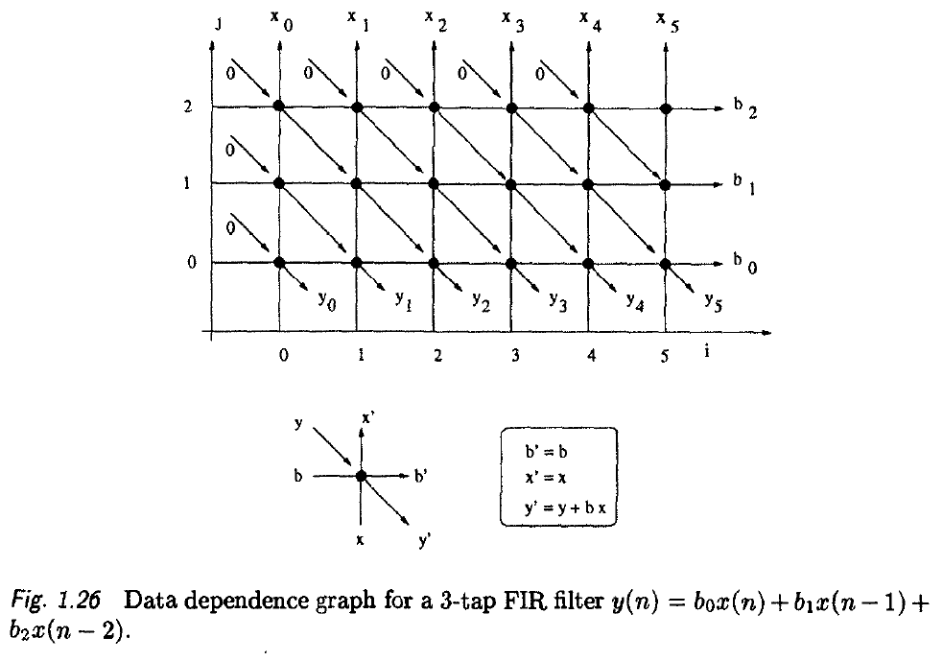
DG (Dependency Graph)
Note: No delay element!

Slide 17
Chapter 2: Iteration Bound (Giới hạn lặp)
Introduction
Loop Bound (giới hạn vòng)
Important Definitions and Examples
Iteration Bound
Important Definitions and Examples
Techniques to Compute Iteration Bound

Slide 18
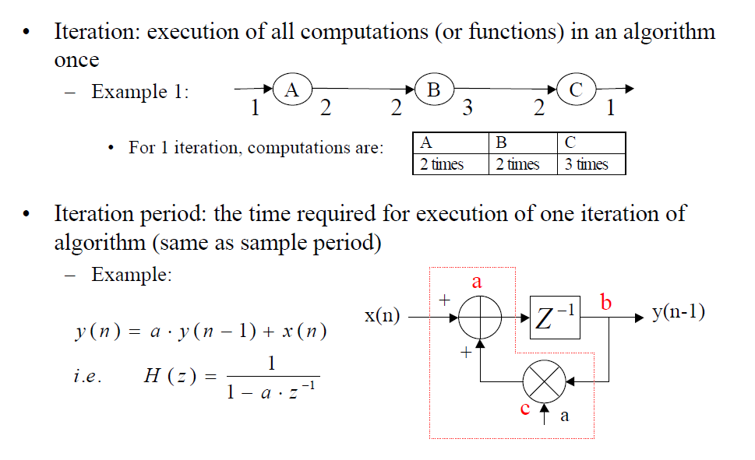
Introduction
Multi-rate DFG

Slide 19
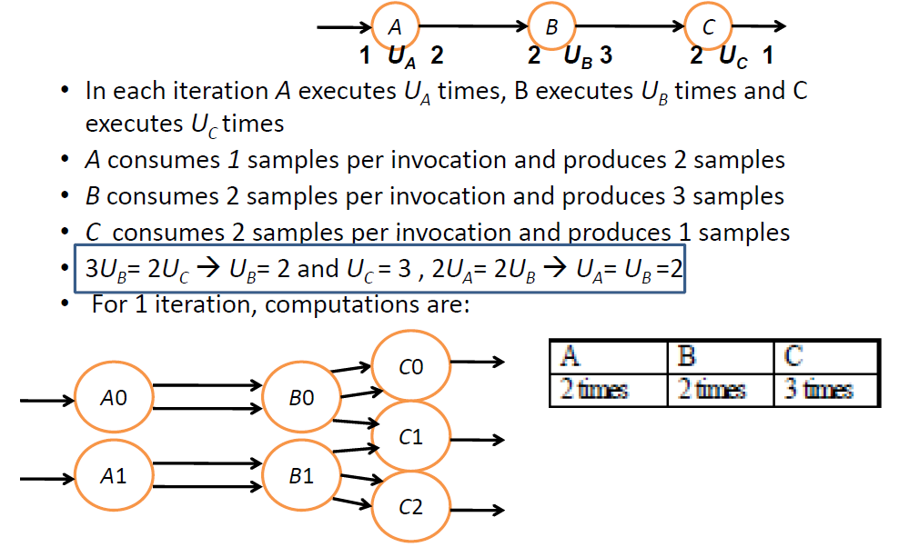
Example : Multirate System

Slide 20
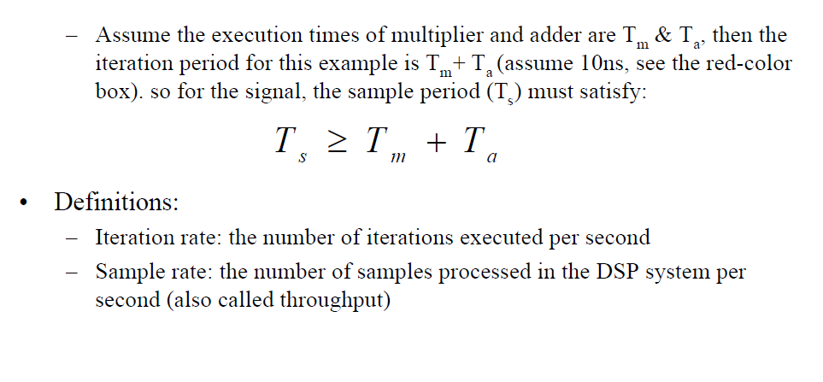
Introduction (cont’d)

Slide 21
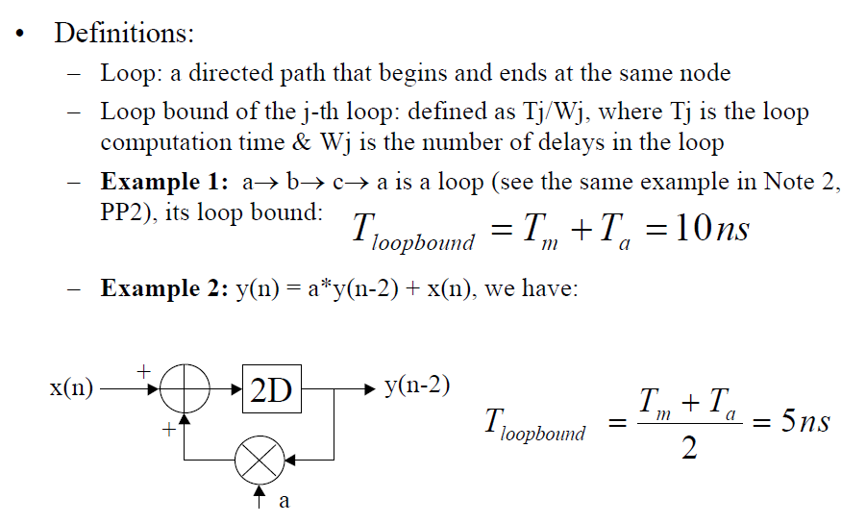
Loop Bound

Slide 22
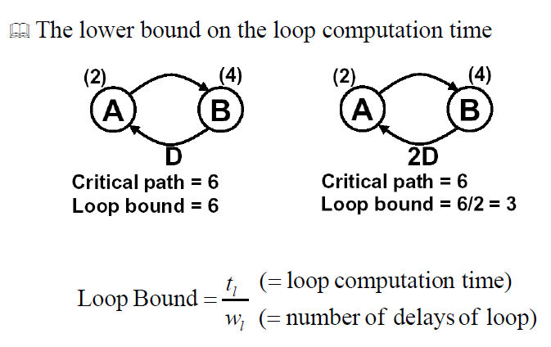
Loop Bound (cont’d)

Slide 23
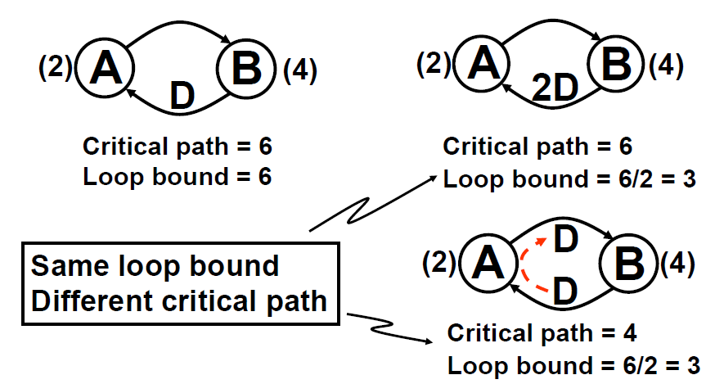
Loop Bound (cont’d)

Slide 24
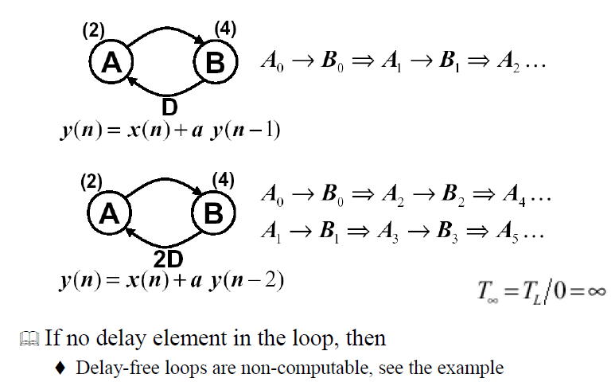
Loop Bound (cont’d)

Slide 25
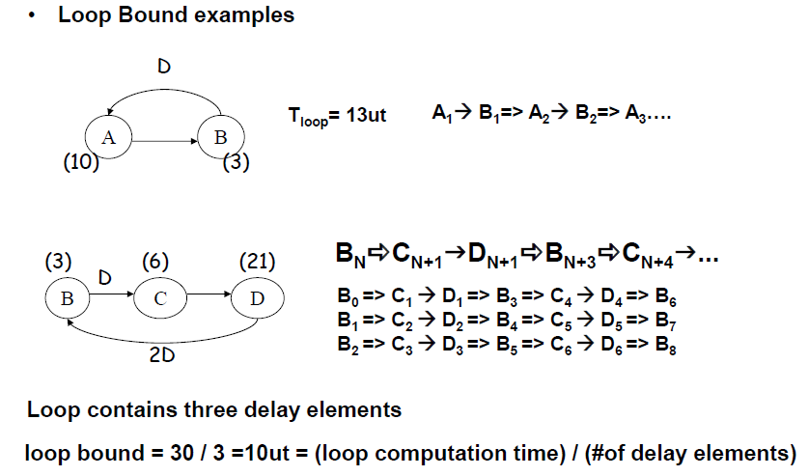

Slide 26
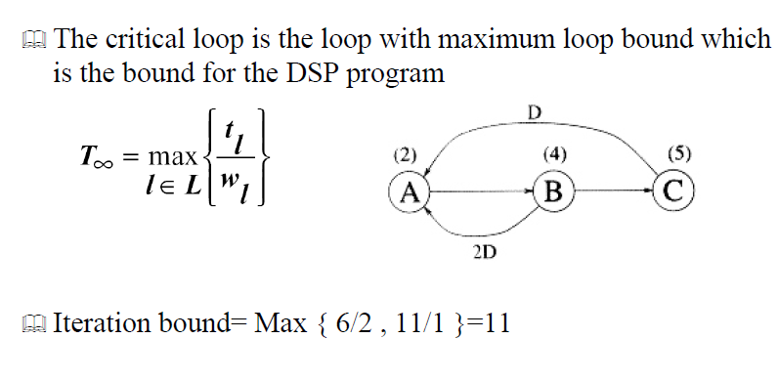
Iteration Bound

Slide 27
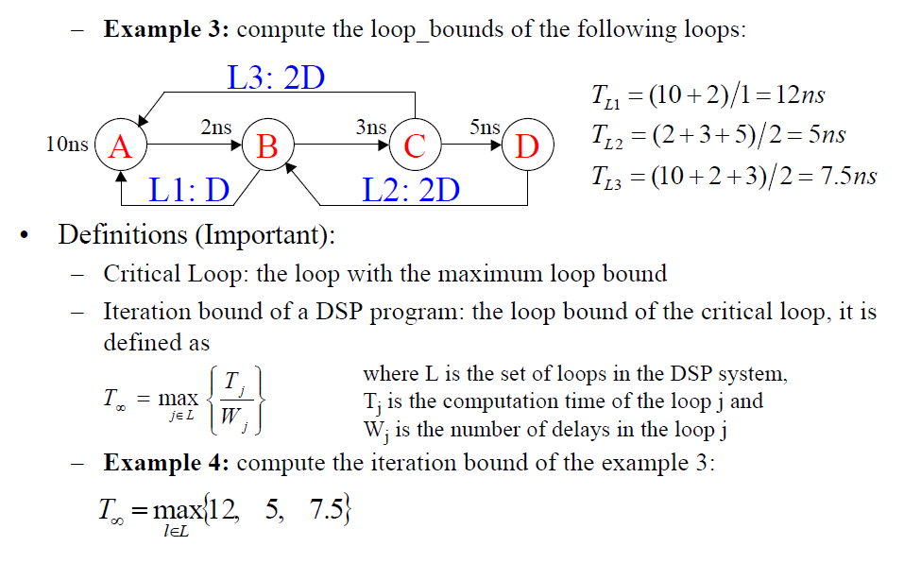
Iteration Bound (cont’d)

Slide 28
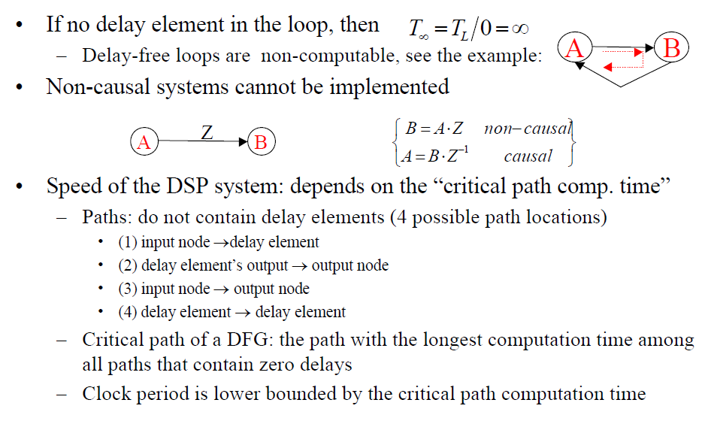
Iteration bound (cont’d)

Slide 29
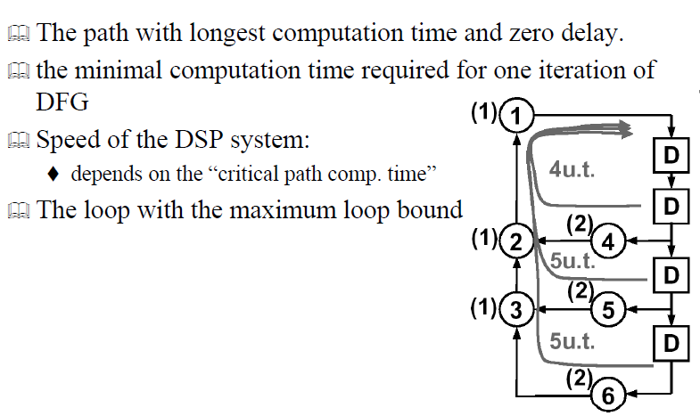
Iteration bound (cont’d) - Critical Path

Slide 30
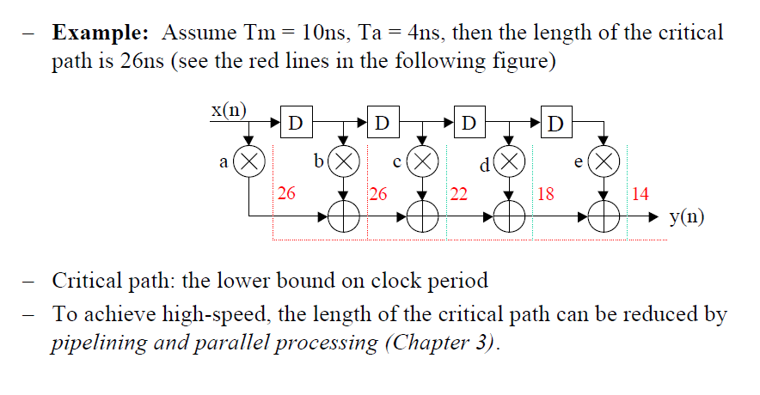
Iteration Bound (cont’d)

Slide 31
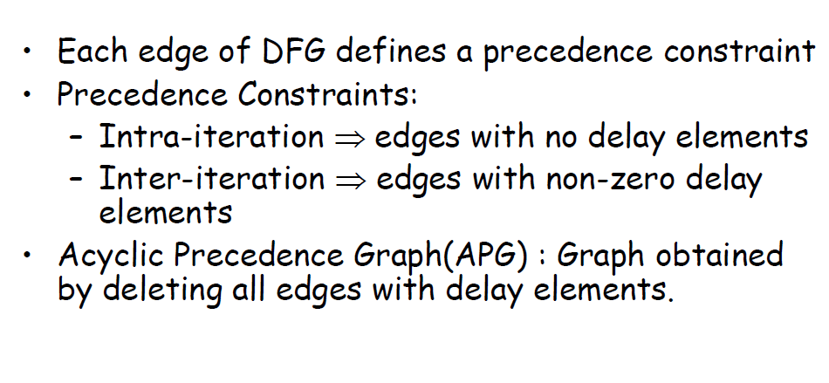
Precedence Constraints

Slide 32
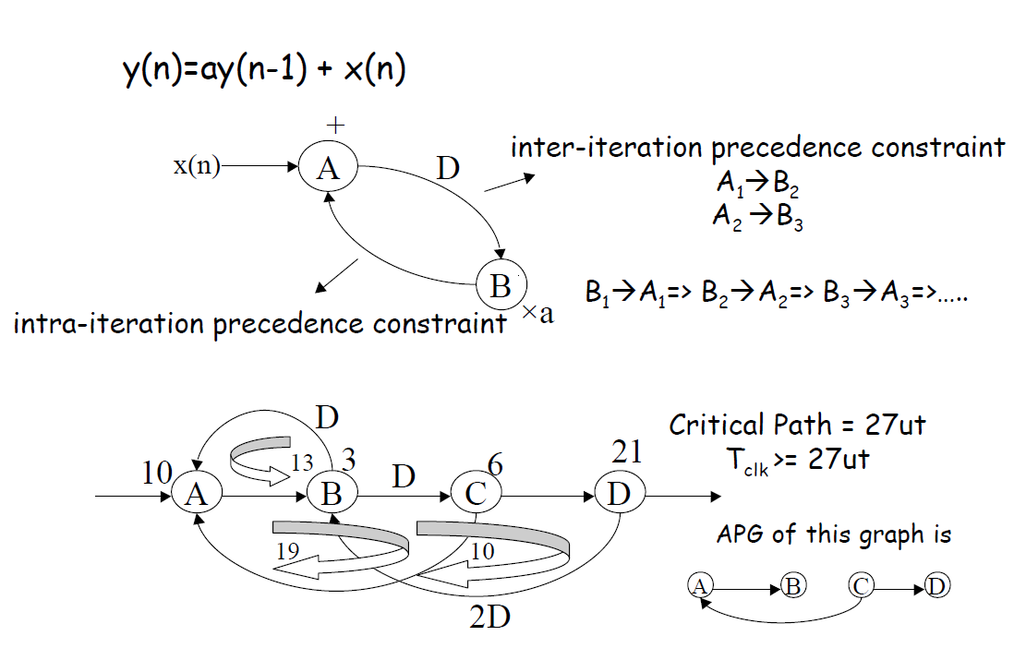

Slide 33
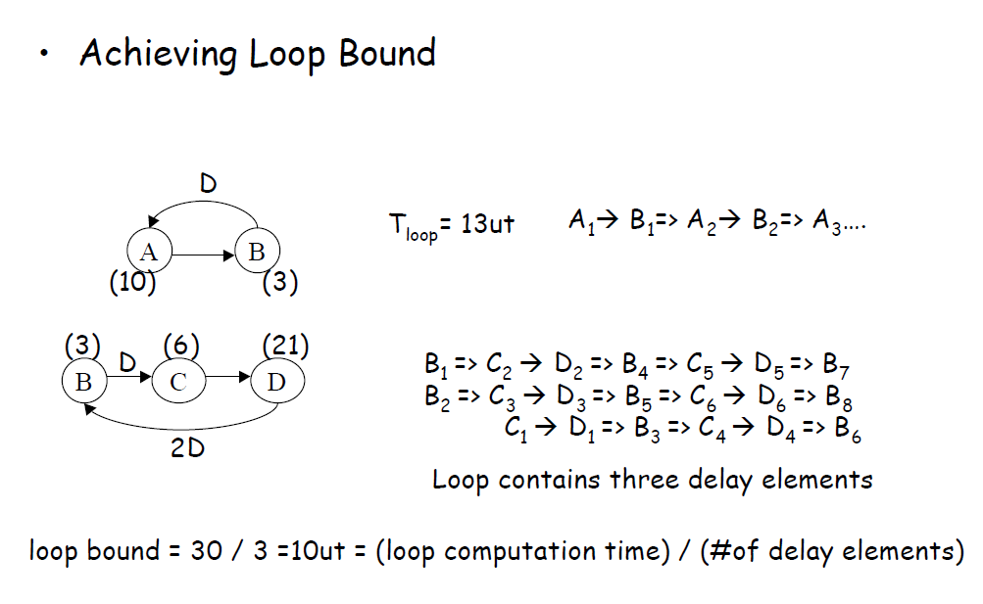

Slide 34
Algorithms to compute iteration bound
– Longest Path Matrix (LPM)
– Minimum Cycle Mean (MCM)

Slide 35
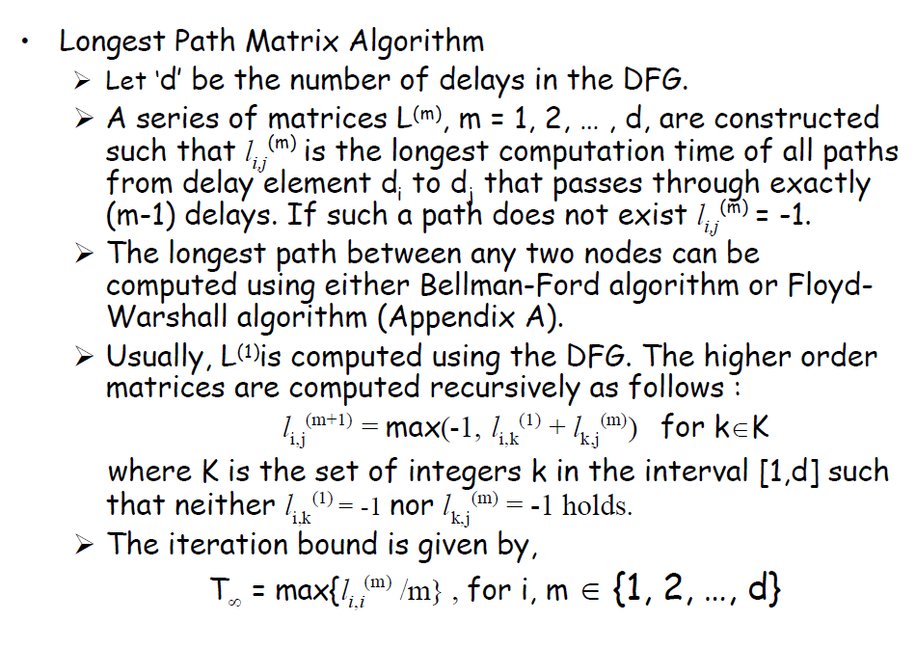
Longest Path Matrix (LPM)

Slide 36
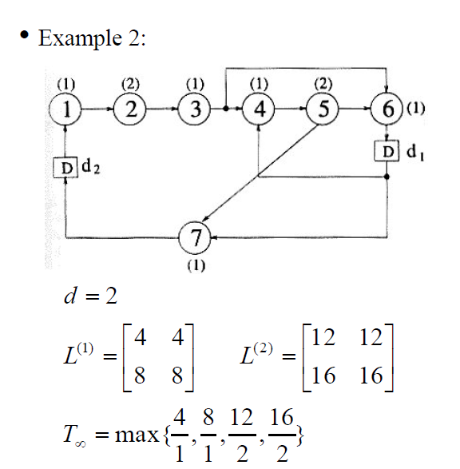
Examples for LPM

Slide 37
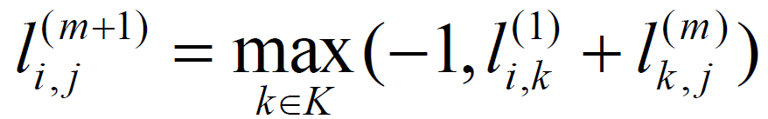
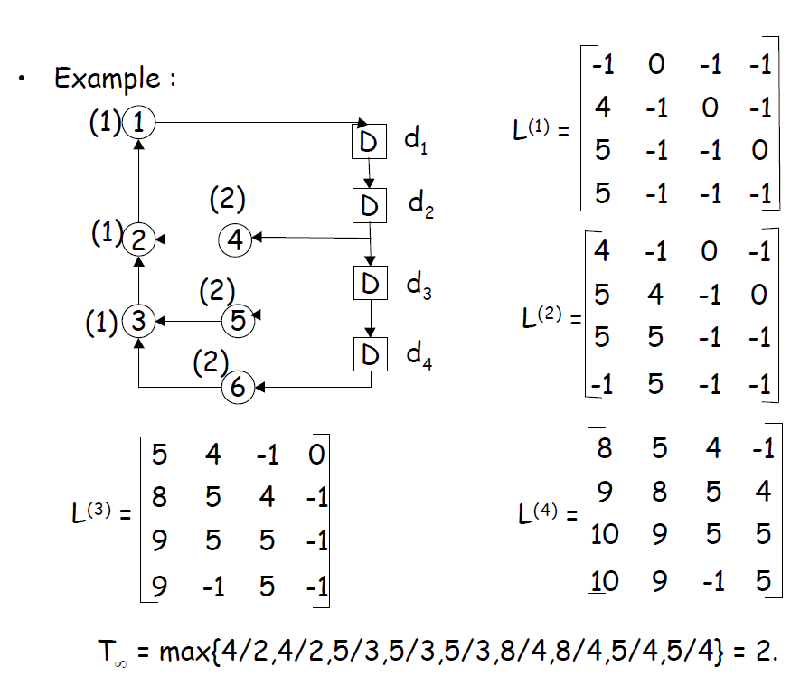

Slide 38
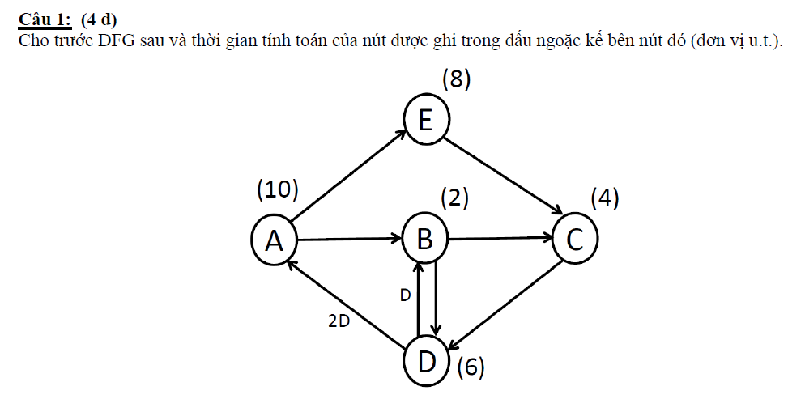
TD: Đề KTGHK cũ

Slide 39
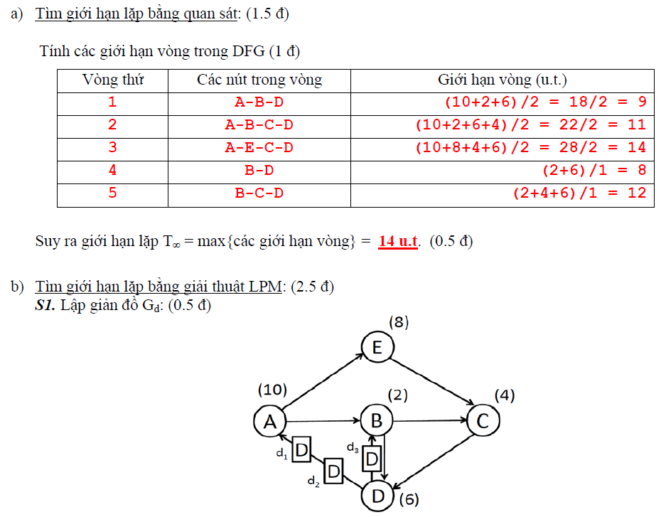

Slide 40
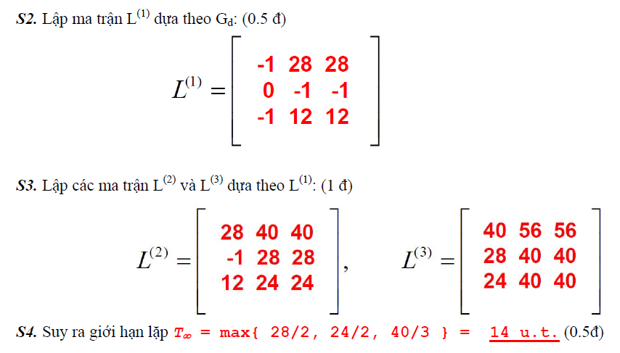

Slide 41
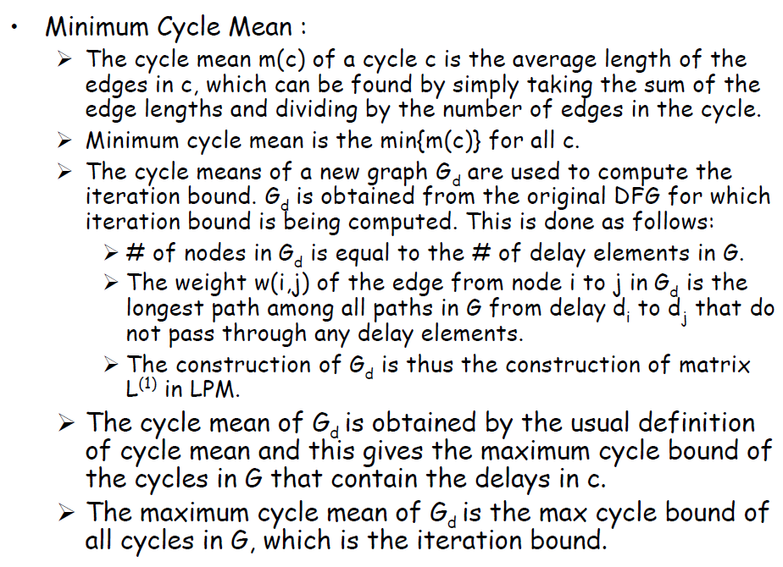
Minimum Cycle Mean Method (MCM)

Slide 42
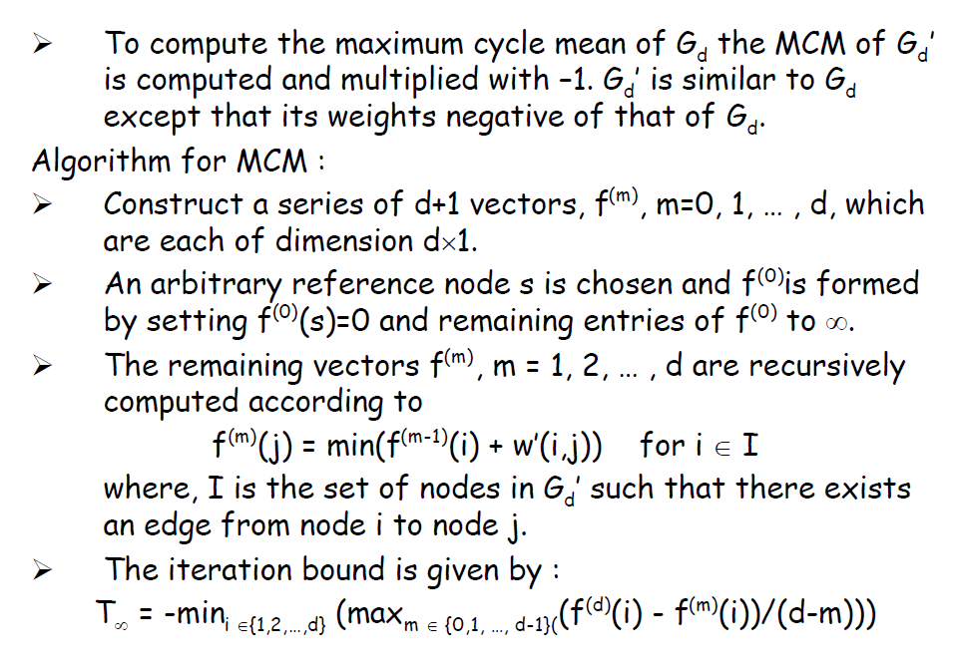

Slide 43
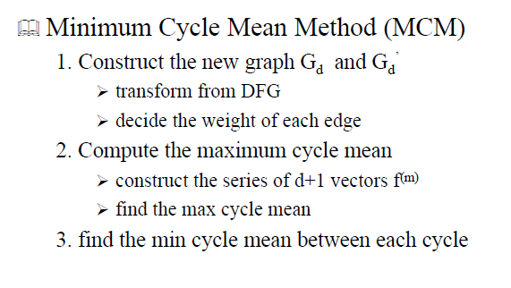

Slide 44
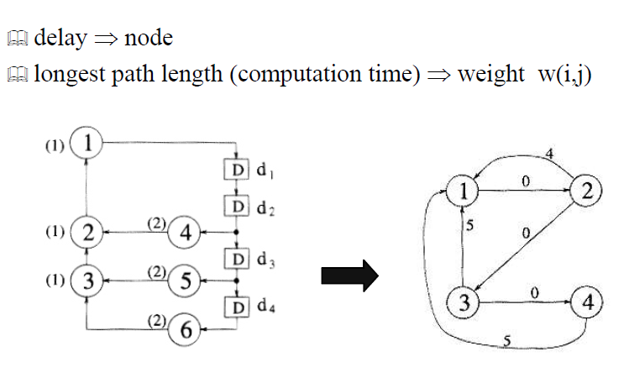
Example to MCM

Slide 45
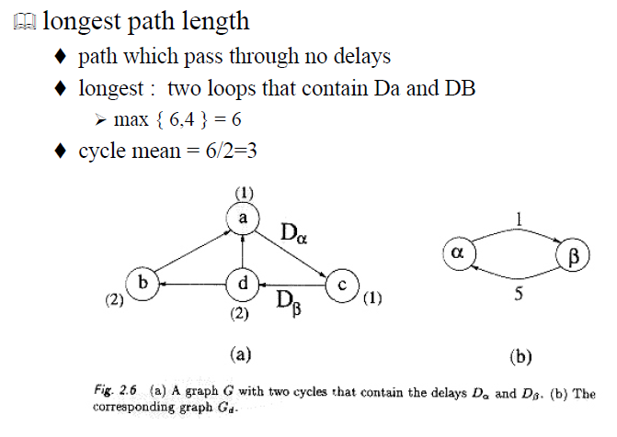
Example to MCM (cont’d)

Slide 46
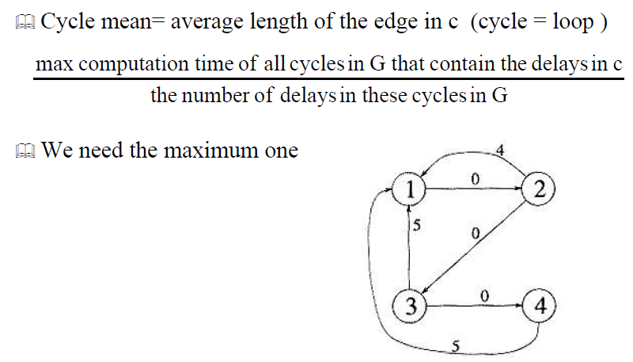
Example to MCM (cont’d)

Slide 47
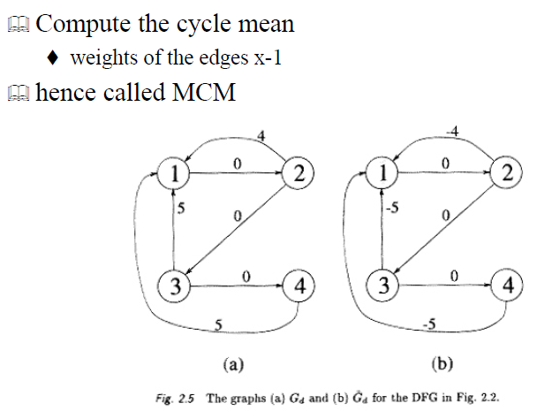
Example to MCM (cont’d)

Slide 48
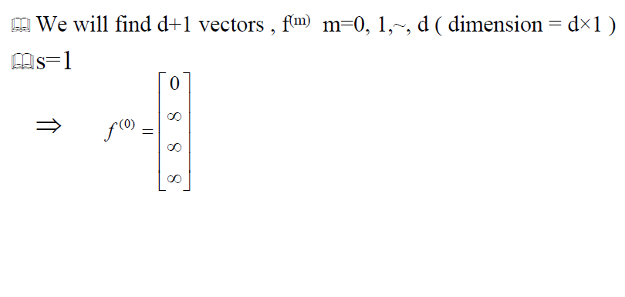
Example to MCM (cont’d)

Slide 49
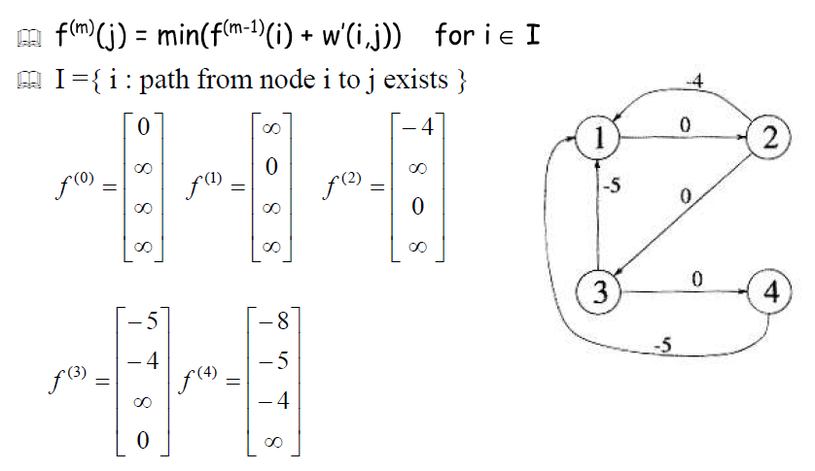
Example to MCM (cont’d)

Slide 50
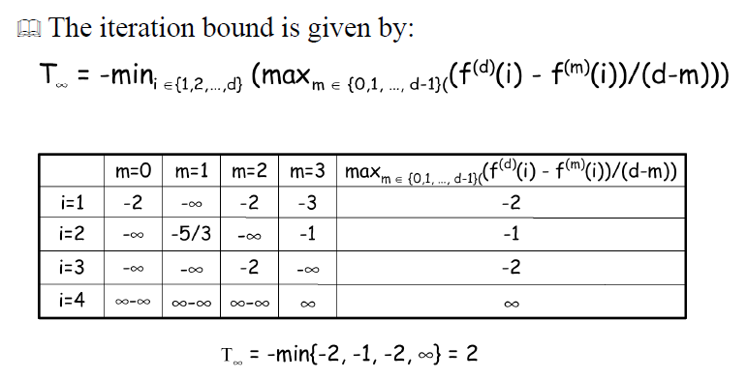
Example to MCM (cont’d)

Slide 51
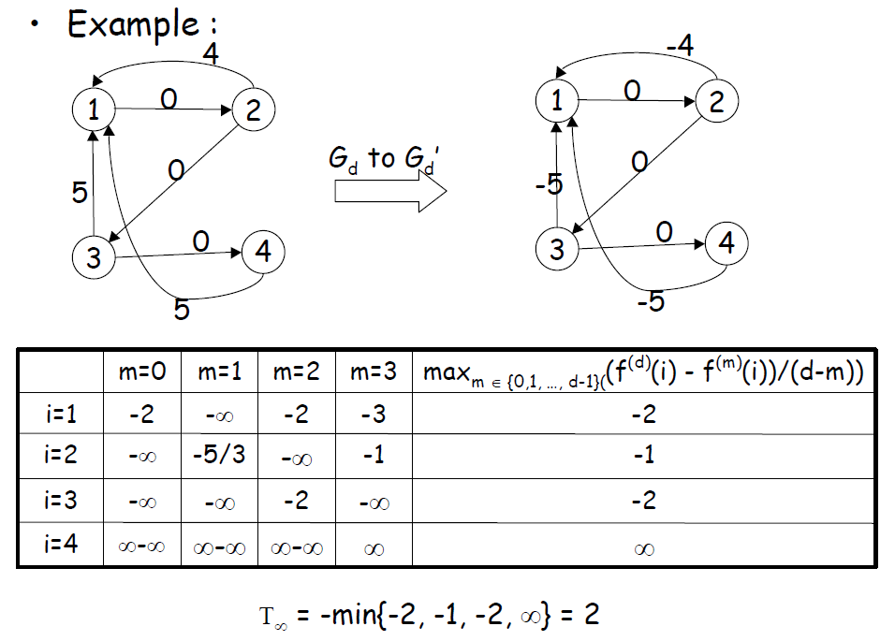

Slide 52
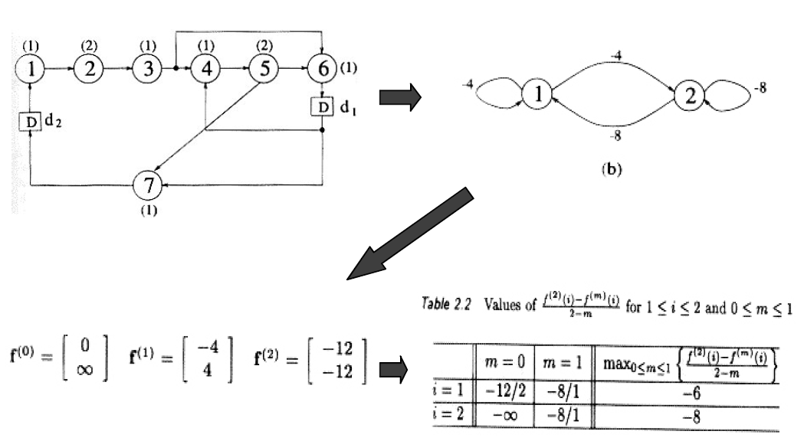
Example to MCM (cont’d)

Slide 53
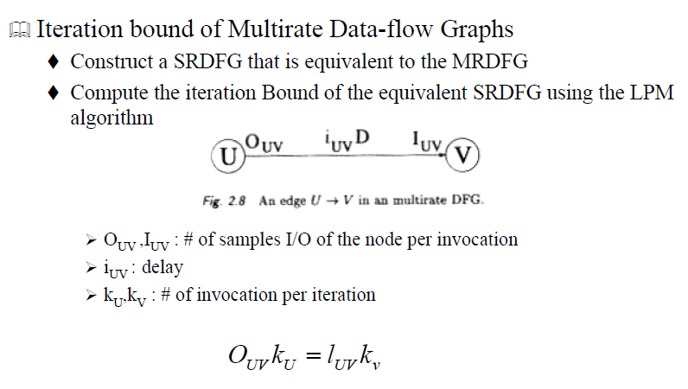
Multirate DFGs

Slide 54

Transformation of Multi Rate DFG

Slide 55

Multi Rate DFG to Single Rate DFG

Slide 56
Conclusion
When the DFG is recursive, the iteration bound is the fundamental limit on the minimum sample period of a hardware implementation of the DSP program.
Two algorithms to compute iteration bound, LPM and MCM, were explored.

